Slide 1
Importing data &
troubleshooting
Slides CC BY-SA

Slide 2
Visualize
Import
Tidy
Model
Reason
Communicate
Transform
Program
Notes:
Let’s talk about some more imports

Slide 3
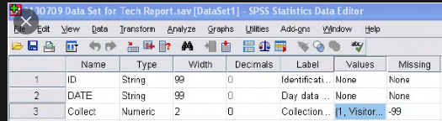
Import from SPSS & Co
Survey datasets contain questions, values and labels (for questions and values)
R has no inbuilt support for question labels
Categorical value labels -> factor levels
Continuous/ordered value labels -> problematic
Solutions:
haven package,
separate codebook &
good variable names
Also, no support for
multiple types
of missingness – check imports!

Slide 4
Your Turn 1
In 05-Final-Exercises.Rmd:
Use haven::read_sav() to import the Qualtrics example file
Follow the instructions to explore the dataset
04:00
4

Slide 5
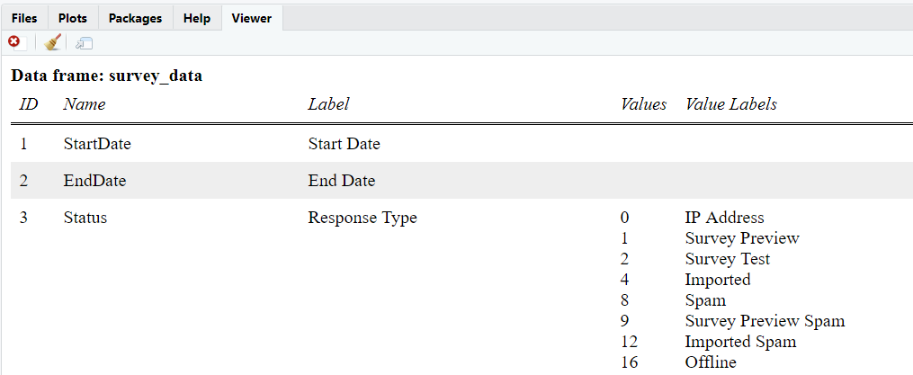

sjPlot::view_df(survey_data) offers good codebook … open in browser
Can also specify file = "name.html" in function call

Slide 6
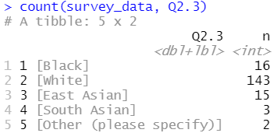
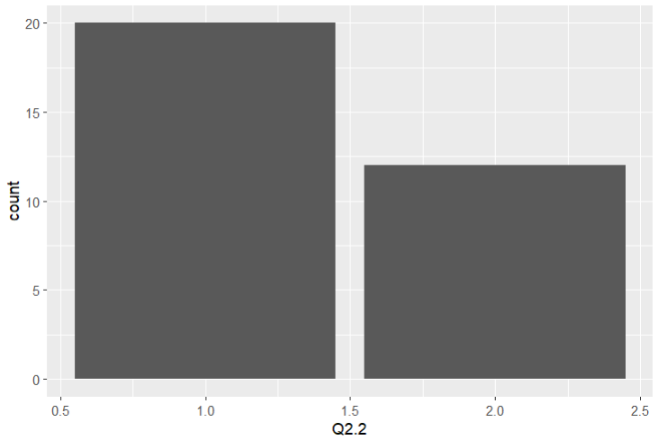
Value labels only partly supported

Slide 7
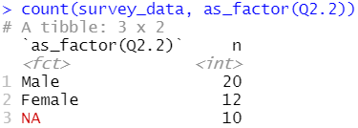
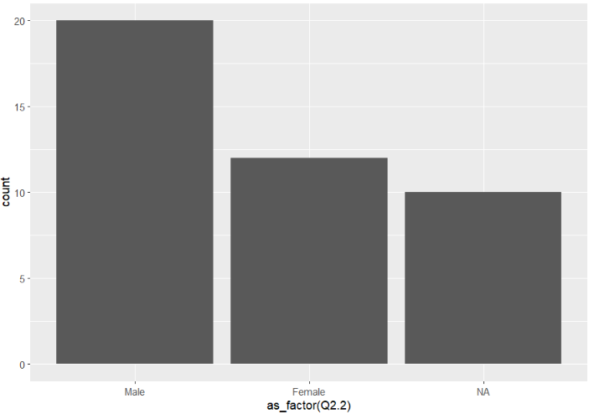
Convert to factors

Slide 8
Rename variables
In dplyr:
rename(new_name = old_name, …)
Or by changing names() directly:
names(survey_data) <- str_replace(names(survey_data), “_DO_”, “_order_”)

Slide 9
Your Turn 2
Make a factor variable gender based on Q2.2
Rename Q2.1 to age
Replace Q1.2_ in variable names with consent
04:00
9

Slide 10
survey_data <- survey_data %>%
mutate(gender = as_factor(Q2.2)) %>%
rename(age = Q2.1) %>%
set_names(names(.) %>%
str_replace("Q1.2_", "consent")
#or
names(survey_data) <- names(survey_data) %>%
str_replace("Q1.2_", "consent")

Slide 11


Create scales
Usually, need to combine items into scale scores
Here, UCLA loneliness scale, Warwick-Edinburgh Mental Wellbeing scale (Q60_1 to Q60_11) and a Covid prevention scale (Q61_1 to Q61_12)
We could:
Use mutate() to create means
Use psych::alpha() to assess Cronbach’s alpha or MBESS::ci.reliability() for omega
Or just
make_scales()

Slide 12
make_scales()
?make_scales
make_scales(data, items, reversed = FALSE)
Arguments listed with value are optional – but check what default does
“Items in a list of named character vectors”
list(scale1 = c("item1", "item2"), scale2 = c("item3", …) )

Slide 13
paste0()
paste() adds spaces
scale + id
"motivation" + (1,2,3,…,10)
"Q7_" + (1,2,3,…,10)
c("motivation1", "motivation2", "motivation3" …)
Don’t repeat yourself!
paste0("motivation“, c(1,2,3,4,5,6,7,8,9,10))
paste0("motivation“, 1:10)

Slide 14
Your Turn 3
Complete the code to calculate the three scales
Calculate the scale scores
Look at the outputs
Combine the scale values with the dataset (bind_cols)
04:00
14

Slide 15
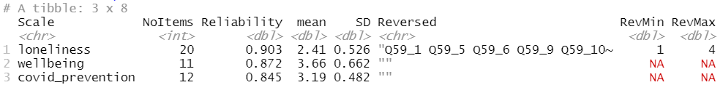
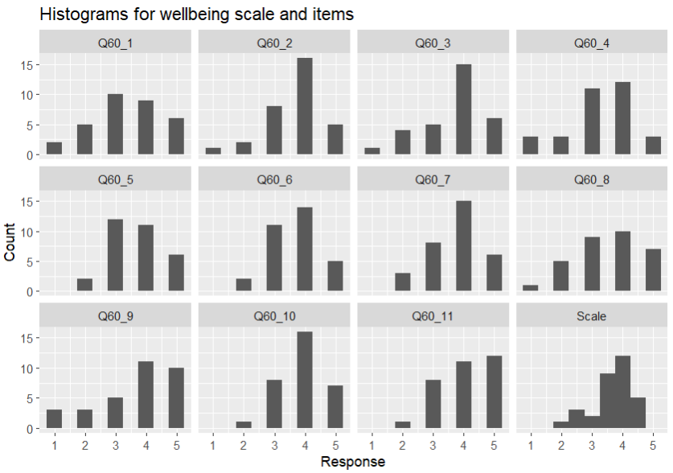
scales <- make_scales(survey_data, scales_items, reversed = TRUE)
scales$descriptives
survey_data <- survey_data %>% bind_cols(scales$scores)

Slide 16
Final topics
Reproducibility
Version control
Further RMarkdown uses

Slide 17

Let’s actually make it reproducible!
Code must be
saved (& available)
complete (i.e. create all results)
comprehensible (i.e. commented)
robust

Slide 18
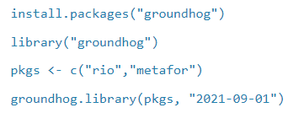

Robust code in a dynamic ecosystem?
Code ages quickly – R code, dependent on many packages, even faster
Updates break things
Once they work, make it groundhog day
Notes:
Might see renv – similar but more advanced tool

Slide 19

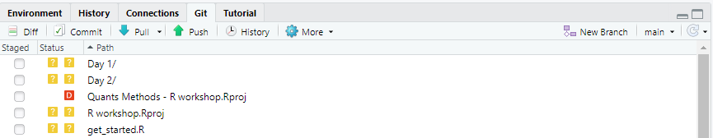
git version control
Keep track of your work
Undo mistakes – at any time – and recover exploratory attempts
Collaborate easily
Do work → Commit (with name) → Upload
Review / revert at any time
Run usethis::git_vaccinate()

Slide 20
How to get started?
Set-up instructions here
If you just want continuous backups, check my git lazy shortcut :)
Explore GitHub – a server for git (and the home for most R package development)

Slide 21
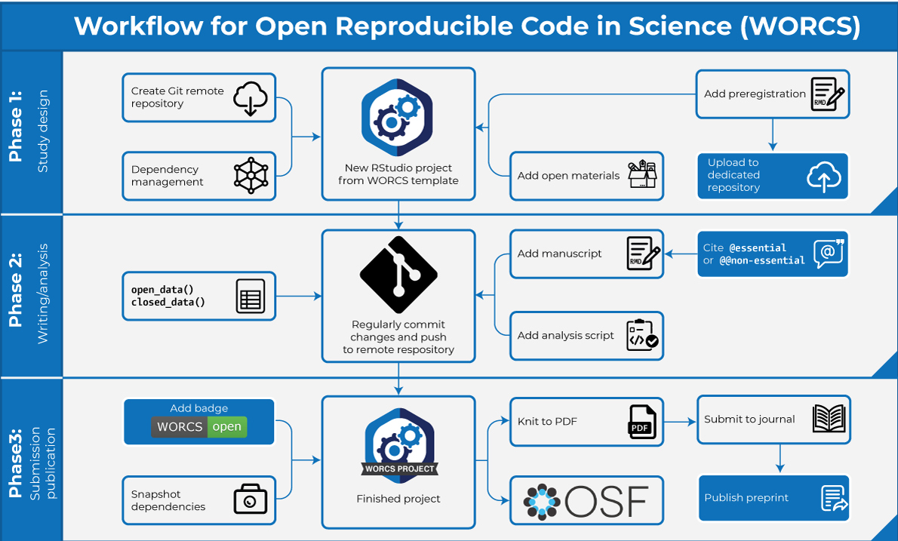
WORCS – an emerging gold standard?

Slide 22



Using RMarkdown further
“Books” and webpages:
My R module page and its source
Journal articles
papaja package and templates
Reports:
In-text code
Parameters
Look at 05-Report-Parameters-Example.Rmd

Slide 23



Coding: Stackoverflow
Stats:
CrossValidated
Minimum reproducible examples (reprex) – simple data, simple model, …
Report unexpected behaviour on GitHub Issues
Restart R … and your brain

Slide 24


Slide 25

25

Slide 26

Congratulations &
Thank you!

